Slide 1
COMP 520 - Compilers
Lecture 14 – PA4 Intro

Slide 2
PA3 Reminder
It is due this Friday at 11:59pm
If you haven’t started, start immediately!
Can be somewhat tricky when you reach QualRef
COMP 520: Compilers – S. Ali

Slide 3
Recall
These assignments build on each other.
By thinking ahead and preparing for PA4, you know the goal of PA3
COMP 520: Compilers – S. Ali

Slide 4
Quick Review of PA3
Not just how to do it, but important notes related to PA4
COMP 520: Compilers – S. Ali

Slide 5
Identification
Idea: Map each identifier to a Declaration
A declaration is:
Vardecl
ParameterDecl
FieldDecl
MethodDecl
LocalDecl
MemberDecl
COMP 520: Compilers – S. Ali

Slide 6
Identification
Red Arrows: IDTable goes from “String” to Declaration
Orange Arrows:
Identifier checks IDTable for “where am I declared?”
COMP 520: Compilers – S. Ali

Slide 7
Identification Goal
Look up where the identifier is declared.
Store it in my Identifier AST’s field “decl”
Now I don’t need the IDTable / SI
with: Identifier id id.spelling = “x”
Scoped ID
“x” maps to…
with: Identifier id id.decl = findDecl(id.spelling,currentCtx);
COMP 520: Compilers – S. Ali

Slide 8
Identification
All references, except ThisRef, contain an identifier.
This means if every Identifier maps to a Declaration…
If you take special care for “ThisRef,” then all references also map to an Identifier, which maps to a Declaration.
COMP 520: Compilers – S. Ali

Slide 9
QualRef Quick Review
From Lec09
COMP 520: Compilers – S. Ali

Slide 10
QualRef Definition
Two Fields:
Reference ref;
Identifier id;
Grammar: (this|id)(.id)*
The grammar is misleading. The grammar is meant for parsing.
COMP 520: Compilers – S. Ali

Slide 11
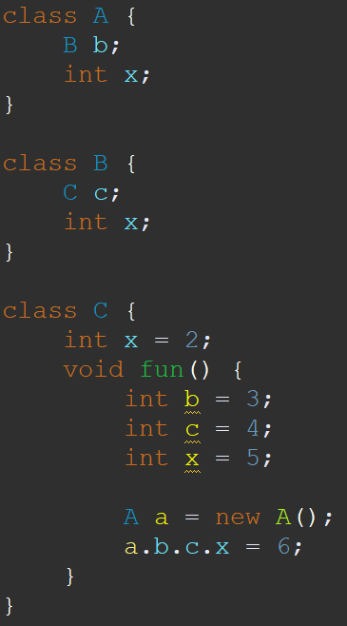
In this example..
Class A: contains member: B b;
Class B: contains member: C c;
Class C: contains member: int x;
Where is a.b.c.x?
COMP 520: Compilers – S. Ali

Slide 12
Consider: a.b.c.x
QualRef: a.b.c.x
Reference ref = “a.b.c”
Identifier id = “x”
Same as slide 81, Lec09
COMP 520: Compilers – S. Ali

Slide 13
Consider: a.b.c.x
Reference ref = “a.b.c”
Identifier id = “x”
Strategy: Visit LHS, resolve RHS in context of LHS
COMP 520: Compilers – S. Ali

Slide 14
Consider: a.b.c.x
Strategy: Visit LHS, resolve RHS in context of LHS
QualRef | Left-Hand-Side (ref) | Right-Hand-Side (id)
a.b.c.x | a.b.c (QualRef) | x
COMP 520: Compilers – S. Ali

Slide 15
Consider: a.b.c.x
Strategy: Visit LHS, resolve RHS in context of LHS
QualRef | Left-Hand-Side (ref) | Right-Hand-Side (id)
a.b.c.x | a.b.c (QualRef) | x
a.b.c | a.b (QualRef) | c
a.b | a (IdRef) | b
VISIT
VISIT
VISIT
COMP 520: Compilers – S. Ali

Slide 16
Consider: a.b.c.x
Strategy: Visit LHS, resolve RHS in context of LHS
QualRef | Left-Hand-Side (ref) | Right-Hand-Side (id)
a.b.c.x | a.b.c (QualRef) | x
a.b.c | a.b (QualRef) | c
a.b | a (IdRef) | b
Context of “a” is class “A”, resolve “b” in ctx of “A”
VISIT
COMP 520: Compilers – S. Ali

Slide 17
Consider: a.b.c.x
Strategy: Visit LHS, resolve RHS in context of LHS
QualRef | Left-Hand-Side (ref) | Right-Hand-Side (id)
a.b.c.x | a.b.c (QualRef) | x
a.b.c | a.b (QualRef) | c
a.b | CTX: “A” | b
Context of “a” is class “A”, resolve “b” in ctx of “A”
VISIT
RETURN CONTEXT
COMP 520: Compilers – S. Ali

Slide 18
Consider: a.b.c.x
Strategy: Visit LHS, resolve RHS in context of LHS
QualRef | Left-Hand-Side (ref) | Right-Hand-Side (id)
a.b.c.x | a.b.c (QualRef) | x
a.b.c | a.b (QualRef) | c
a.b | CTX: “A” | b
Resolve “b” in ctx of “A”
Set Decl
RETURN CONTEXT
COMP 520: Compilers – S. Ali

Slide 19
Consider: a.b.c.x
Strategy: Visit LHS, resolve RHS in context of LHS
QualRef | Left-Hand-Side (ref) | Right-Hand-Side (id)
a.b.c.x | a.b.c (QualRef) | x
a.b.c | CTX: “B” | c
a.b | CTX: “A” | b
Resolve “c” in context of class “B”
Set Decl
RETURN CONTEXT
COMP 520: Compilers – S. Ali

Slide 20
Consider: a.b.c.x
Strategy: Visit LHS, resolve RHS in context of LHS
QualRef | Left-Hand-Side (ref) | Right-Hand-Side (id)
a.b.c.x | CTX: “C” | x
a.b.c | CTX: “B” | c
a.b | CTX: “A” | b
Resolve “x” in context of class “C”
Set ID’s Declaration
RETURN CONTEXT
COMP 520: Compilers – S. Ali

Slide 21
Special Considerations
Take care for private variable access
Plan first, code afterwards
COMP 520: Compilers – S. Ali

Slide 22
Type-Checking
Covered extensively in earlier lectures
Recall: no type-casting in miniJava
Recall: no automatic type-casting in miniJava
Recall: declarations have a type associated with them. Afterall, this is where they are declared. Thus: if you know an identifier’s declaration, you know what type it is.
COMP 520: Compilers – S. Ali

Slide 23
Type-Checking (2)
Your goal is to implement type-checking, not only suggestions in the assignment instructions
At each visit method, ask yourself, “What am I assuming about the types that I have?”
COMP 520: Compilers – S. Ali

Slide 24
PA4 – Code Generation
What makes a compiler, a compiler!
COMP 520: Compilers – S. Ali

Slide 25
About a month to do PA4
PA4 is 3 programming assignments:
Assembler (opcode generation)
Code generation (organizing your assembly)
ELF generation (packaging your code in a way that it can be loaded by x86_64 linux)
COMP 520: Compilers – S. Ali

Slide 26
Dealing with Decision Paralysis
If your compiler can generate Linux executable binaries, and the output of that binary matches the autograder, then you get points.
COMP 520: Compilers – S. Ali

Slide 27
Dealing with Decision Paralysis
If your compiler can generate Linux executable binaries, and the output of that binary matches the autograder, then you get points.
This means you have a LOT of control over how you organize your compiler.
(Note, cannot use others code, or GitHub, etc., etc.)
COMP 520: Compilers – S. Ali

Slide 28
Optimization
Your x86_64 code generation does not have to be optimized.
The thing you’re after: get it working
You can add optimizations in PA5
COMP 520: Compilers – S. Ali

Slide 29
Optimization
Your x86_64 code generation does not have to be optimized.
The thing you’re after: get it working
You can add optimizations in PA5
Plan what you NEED, and FOCUS on those items. The documentation covers everything, but you don’t need everything that x86 has to offer.
COMP 520: Compilers – S. Ali

Slide 30
Useful Resources
ELF File Format: https://en.wikipedia.org/wiki/Executable_and_Linkable_Format
Online ELF Viewer: http://www.sunshine2k.de/coding/javascript/onlineelfviewer/onlineelfviewer.html
Instruction Reference by opcode: http://ref.x86asm.net/coder64.html
… sorted by name: http://ref.x86asm.net/coder64-abc.html
Instruction Descriptions: https://www.felixcloutier.com/x86/
Intel x86_64 documentation: https://www.intel.com/content/www/us/en/developer/articles/technical/intel-sdm.html
Decoder/Encoder: https://defuse.ca/online-x86-assembler.htm#disassembly2 (make sure to check x64)
COMP 520: Compilers – S. Ali

Slide 31
Testing Ability
When PA4 assignment instructions release, additional testing instructions will release.
You will be able to remote into a machine where you can use readelf and objdump binaries.
You can upload your binaries and INPUT java files, but not your project files.
Handy for testing.
COMP 520: Compilers – S. Ali

Slide 32
readelf / objdump
readelf: Helpful for making sure your ELF file can be read properly
objdump: Helpful for making sure your encoded assembly is accurate
COMP 520: Compilers – S. Ali

Slide 33
Let’s get started on x86_64
COMP 520: Compilers – S. Ali

Slide 34
Target Architecture: x86_64
The slides and instructions will use x64
You can still do x86 binaries if you find it easier.
Target is LITTLE ENDIAN (What is Java?)
Lecture Goals: Target the more difficult x64
COMP 520: Compilers – S. Ali

Slide 35
Suggested order
1. First do the assembler (convert “pop rax” to bytes)
Use resources #3, #4, #5, #6
2. Confirm the assembler is working fine (using #7)
3. Do the code generator (visitor implementation)
4. Confirm it is outputting the correct code (using #7)
5. Create ELF scaffolding (using #1, #2)
COMP 520: Compilers – S. Ali

Slide 36
Code generation in RISC
Often: fixed-length instructions
Often: easy to understand, simple instructions
MIPS example: add r8,r11,r23
COMP 520: Compilers – S. Ali

Slide 37
Code generation in RISC
Often: fixed-length instructions
Often: easy to understand, simple instructions
MIPS example: add r8,r11,r23
000000 01000 01010 10111 00000 100000
Opcode Reg1 Reg2 Reg3 FD Function
COMP 520: Compilers – S. Ali

Slide 38
MIPS (and other RISC ISAs) is beautiful
Fixed length operations
Intuitive to encode and decode
COMP 520: Compilers – S. Ali

Slide 39
RISC and CISC can’t be that different??
Surely, most things should translate.
Have an “opcode”
Have register operands encoded by their index
Have a “function” if the opcode is shared by several instructions (add, sub, xor, or, cmp, etc.)
COMP 520: Compilers – S. Ali

Slide 40
Our target architecture is CISC
We get to use instructions like:
mov dword[rsi+rcx*4+0x0520],edx
Encoded as:
89 94 8E 20 05 00 00
COMP 520: Compilers – S. Ali

Slide 41
In-class Exercise, Let’s encode!
I want to encode: mov rcx,rdx
Pseudocode: rcx := rdx;
COMP 520: Compilers – S. Ali

Slide 42
mov rcx,rdx
Let’s say the opcode for this mov is 0x89
We find 0x89, and it says: mov rm,r
So register1 is called “rm”, and register2 is called “r”
…for now
COMP 520: Compilers – S. Ali

Slide 43
mov rcx,rdx
Let’s say the opcode for this mov is 0x89
So far so good, write “0x89” to our bytecode
Go to the register encoding table: http://ref.x86asm.net/coder64-abc.html#modrm_byte_32_64
COMP 520: Compilers – S. Ali

Slide 44
How do we read this?
COMP 520: Compilers – S. Ali

Slide 45
How do we read this? (mov rcx,rdx)
Operand “r” Find: RDX
COMP 520: Compilers – S. Ali

Slide 46
How do we read this? (mov rcx,rdx)
Operand “r” Find: RDX
Plain registers
Operand “rm” Find: RCX
COMP 520: Compilers – S. Ali

Slide 47
How do we read this? (mov rcx,rdx)
Operand “r” Find: RDX
Operand “rm”
Plain registers: Find: RCX
D1
COMP 520: Compilers – S. Ali

Slide 48
mov rcx,rdx
So far:
Opcode= 0x89
Registers rcx,rdx: 0xD1
Let’s go to our handy-dandy tool: and plug in 89 D1
https://defuse.ca/online-x86-assembler.htm#disassembly2
COMP 520: Compilers – S. Ali

Slide 49
Was the result: mov rcx,rdx?
89 D1
COMP 520: Compilers – S. Ali

Slide 50
Output was…
mov ecx,edx
COMP 520: Compilers – S. Ali

Slide 51
We were very close
If we want to use 64-bit registers, we need to use something called the “REX” prefix.
x86_64 requires you to use “prefix” bytes to determine whether you’re using 32-bit registers or 64-bit registers and operands
COMP 520: Compilers – S. Ali

Slide 52
Recall: New 64-bit registers
Register Index from [0,7]
RAX, RCX, RDX, RBX, RSP, RBP, RSI, RDI
New registers use the same index [0,7]
R8, R9, R10, R11, R12, R13, R14, R15
COMP 520: Compilers – S. Ali

Slide 53
REX Prefix: [regB+regX*8+520],regW
REX | Description
B | Use new registers for displacement register
X | Use new registers for index register
R | Use new registers for “r” (regW above)
W | Extend operand (imm, or register “r”) to 64-bit
COMP 520: Compilers – S. Ali

Slide 54
Thus, prefix bytes control registers
Which register gets used is done in the prefix.
If no prefix is specified, x86_64 will assume 32-bit for the most part
Let’s try again with: Rex.W (0x48)
48 89 D1
COMP 520: Compilers – S. Ali

Slide 55
Try again!
Let’s try again with: Rex.W (0x48)
48 89 D1
https://defuse.ca/online-x86-assembler.htm#disassembly2
Proper output: mov rcx,rdx
COMP 520: Compilers – S. Ali

Slide 56
What about the rest of that table?
COMP 520: Compilers – S. Ali

Slide 57
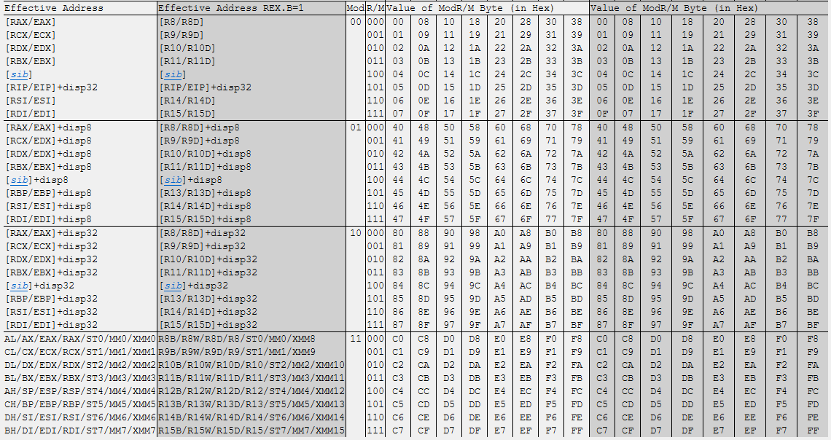
Encoding: mov [rsi+rcx*4+0x520],rdx
First: find RDX in the column like before
COMP 520: Compilers – S. Ali

Slide 58
Encoding: mov [rsi+rcx*4+0x520],rdx
Ask yourself: is our “displacement of 0x520” zero? One byte? Four bytes?
COMP 520: Compilers – S. Ali

Slide 59
Encoding: mov [rsi+rcx*4+0x520],rdx
Ask yourself: is our “displacement of 0x520” zero? One byte? Four bytes?
Zero
1 byte
4 bytes
COMP 520: Compilers – S. Ali

Slide 60
Encoding: mov [rsi+rcx*4+0x520],rdx
Because we have a “scaled index” of rcx*4, and a displacement of “rsi+0x520”, we pick [SIB]+disp32
Zero
94
1 byte
4 bytes
COMP 520: Compilers – S. Ali

Slide 61
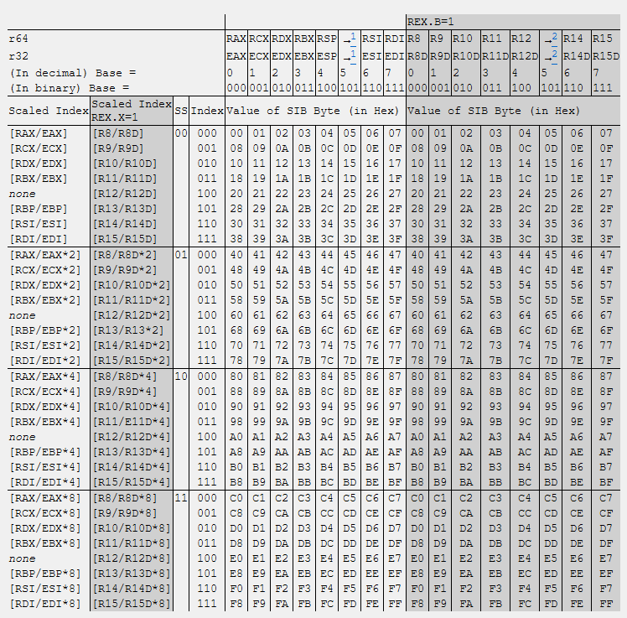
New table: SIB
http://ref.x86asm.net/coder64-abc.html#sib_byte_32_64
COMP 520: Compilers – S. Ali

Slide 62
New table: SIB: [rsi+rcx*4+0x520],rdx
Pick the index RCX*4
COMP 520: Compilers – S. Ali

Slide 63
[rsi+rcx*4+0x520],rdx
Pick the displacement register, RSI
Pick the index RCX*4
COMP 520: Compilers – S. Ali

Slide 64
[rsi+rcx*4+0x520],rdx
Pick the displacement register, RSI
Pick the index RCX*4
8E
COMP 520: Compilers – S. Ali

Slide 65
mov [rsi+rcx*4+0x520],rdx
Prefix: 48
Opcode: 89
Operand RDX with SIB: 94
Index RCX, Displacement RSI: 8E
Anything missing?
COMP 520: Compilers – S. Ali

Slide 66
mov [rsi+rcx*4+0x520],rdx
Prefix: 48
Opcode: 89
Operand RDX with SIB: 0x94
Index RCX, Displacement RSI: 0x8E
Last step: encode 0x0520, we specifically are using “disp32” (4 bytes)
COMP 520: Compilers – S. Ali

Slide 67
mov [rsi+rcx*4+0x520],rdx
End Result:
48 89 94 8E 20 05 00 00
REX, MOV, RDX, RSI+RCX*4, 0x520
COMP 520: Compilers – S. Ali

Slide 68
What about: mov rdx,[rsi+rcx*4+0x520]
We want to read from memory and store it in RDX
From what you have learned from previous ISAs, what would you think happens?
COMP 520: Compilers – S. Ali

Slide 69
What about: mov rdx,[rsi+rcx*4+0x520]
We want to read from memory and store it in RDX
Intuitively, one could assume it just flips the order of the bytes.
48 89 94 8E 20 05 00 00
REX, MOV, RDX, RSI+RCX*4, 0x520
Can we just do this?
COMP 520: Compilers – S. Ali

Slide 70
mov rdx,[rsi+rcx*4+0x520]
If we try: 48 89 8E 94 20 05 00 00
The output we get is:
mov [rsi+0x52094],rcx
Uh oh…
COMP 520: Compilers – S. Ali

Slide 71
Register “RM” vs Register “R”
“RM” – registers and memory operations can happen when your operand is “RM”
“R” – only registers
The opcode 0x89 is: mov rm,r
The opcode 0x8B is: mov r,rm
COMP 520: Compilers – S. Ali

Slide 72
The order of operands is determined by the opcode!
The type of operands is determined by the opcode!
If we look at ADD: https://www.felixcloutier.com/x86/add
There are r/m8: AL, CL, DL, BL, AH, CH, DH, BH
There are r/m32: EAX, ECX, EDX, EBX, ESP, EBP, ESI, EDI
There are r/m64: [prefix needed] RAX, RCX, RDX,…
COMP 520: Compilers – S. Ali

Slide 73
Second Look: [regB+regX*8+520],regW
REX | Description
B | Use new registers for displacement register
X | Use new registers for index register
R | Use new registers for “r” (regW above)
W | Extend operand (imm, or register “r”) to 64-bit
COMP 520: Compilers – S. Ali

Slide 74
Second Look: [rax+rcx*8+520],rdx
REX | Description
B | Use new registers for displacement register
X | Use new registers for index register
R | Use new registers for “r” (regW above)
W | Extend operand (imm, or register “r”) to 64-bit
COMP 520: Compilers – S. Ali

Slide 75
Second Look: [rax+rcx*8+520],r10
REX | Description
B | Use new registers for displacement register
X | Use new registers for index register
R | Use new registers for “r” (regW above)
W | Extend operand (imm, or register “r”) to 64-bit
COMP 520: Compilers – S. Ali

Slide 76
Second Look: [r11+rcx*8+520],r10
REX | Description
B | Use new registers for displacement register
X | Use new registers for index register
R | Use new registers for “r” (regW above)
W | Extend new (imm, or register “r”) to 64-bit
COMP 520: Compilers – S. Ali

Slide 77
Second Look: [rax+r8*8+520],edx
REX | Description
B | Use new registers for displacement register
X | Use new registers for index register
R | Use new registers for “r” (regW above)
W | Extend operand (imm, or register “r”) to 64-bit
COMP 520: Compilers – S. Ali

Slide 78
Overview
Registers are encoded with one register being “rm” that allows displacement and indexing a memory read
Another register can be “r” which is always a plain register that resolves to some value
Some trickier operations coming up: “push X” only takes one operand, so which is it? RM? R?
COMP 520: Compilers – S. Ali

Slide 79
Shared Opcodes
COMP 520: Compilers – S. Ali

Slide 80
Just like in MIPS
Recall: https://www.cs.unc.edu/~montek/teaching/Comp541-Fall23/Lab8/MIPS_Green_Sheet.pdf
In MIPS: ADD, JMP, NOR, OR, SLT, SHR, SHL…
All used opcode 0x00
x86 does something similar.
Open: http://ref.x86asm.net/coder64.html#x81
COMP 520: Compilers – S. Ali

Slide 81
Immediate Operands
ADD, OR, ADC, SBB, AND, SUB, XOR, CMP all use 0x81:
instruction r/m64, imm32
Similarly, 0x83 is: r/m64,imm8
COMP 520: Compilers – S. Ali

Slide 82
Immediate Operands
If you see: 0x81 /0, 0x81 /1, 0x81 /2, etc…
It means your “r/m” field is your desination
It means use register index “r” of 0 for /0, 1 for /1, …
COMP 520: Compilers – S. Ali

Slide 83
Immediate Operands
If you see: 0x81 /0, 0x81 /1, 0x81 /2, etc…
It means your “r/m” field is your desination
It means use register index “r” of 0 for /0, 1 for /1, …
Example: SUB is 0x81 /5
This means that if my register “r” is index 5 (RBP), that means the operation is “subtract immediate”
COMP 520: Compilers – S. Ali

Slide 84
sub r10,0x520
COMP 520: Compilers – S. Ali

Slide 85
sub r10,0x520
Opcode: 0x81 (4 byte immediate)
RegisterR: RBP (5)
COMP 520: Compilers – S. Ali

Slide 86
sub r10,0x520
Opcode: 0x81 (4 byte immediate)
RegisterR: RBP (5)
RegisterRM: R10 (index 2, REX.B=1)
COMP 520: Compilers – S. Ali

Slide 87
sub r10,0x520
Opcode: 0x81 (4 byte immediate)
RegisterR: RBP (5)
RegisterRM: R10 (index 2, REX.B=1)
Encode: 0x49 (REX W+B)
COMP 520: Compilers – S. Ali

Slide 88
sub r10,0x520
Opcode: 0x81 (4 byte immediate)
RegisterR: RBP (5)
RegisterRM: R10 (index 2, REX.B=1)
Encode: 0x49 (REX W+B)
Opcode: 0x81
COMP 520: Compilers – S. Ali

Slide 89
sub r10,0x520
Opcode: 0x81 (4 byte immediate)
RegisterR: RBP (5)
RegisterRM: R10 (index 2, REX.B=1)
Encode: 0x49 (REX W+B)
Opcode: 0x81
Registers: 0xEA (rm= R10, r=RBP)
COMP 520: Compilers – S. Ali

Slide 90
sub r10,0x520
Opcode: 0x81 (4 byte immediate)
RegisterR: RBP (5)
RegisterRM: R10 (index 2, REX.B=1)
Encode: 0x49 (REX W+B)
Opcode: 0x81
Registers: 0xEA (rm= R10, r=RBP)
Immediate: 0x0520 (20 05 00 00)
COMP 520: Compilers – S. Ali

Slide 91
Result of: sub r10,0x0520
49 81 EA 20 05 00 00
COMP 520: Compilers – S. Ali

Slide 92
What’s Left:
We did some simple instruction encoding
Coming up:
Encoding more difficult instructions (and patching)
System calls
Organizing the visitor model, stack framing, and “where is my variable in memory?”
Setting up the ELF header
COMP 520: Compilers – S. Ali

Slide 93
Final notes
We will be doing position-independent code (like a shared object)
You do not have to do this
So long as your compiler outputs a binary that I can run like “./a.out” then that is what matters.
(And of course, output must be correct)
COMP 520: Compilers – S. Ali

Slide 94
Final notes (2)
We will be doing position-independent code (like a shared object)
You do not have to do this
So long as your compiler outputs a binary that I can run like “./a.out” then that is what matters.
(And of course, output must be correct)
COMP 520: Compilers – S. Ali

Slide 95
PA3 Due Tomorrow!
Have a great weekend!
COMP 520: Compilers – S. Ali

Slide 96
End

Slide 97
COMP 520: Compilers – S. Ali

Slide 98
COMP 520: Compilers – S. Ali

Slide 99
COMP 520: Compilers – S. Ali

Slide 100
COMP 520: Compilers – S. Ali

